Slide 1


Pick up Python Event

Slide 2
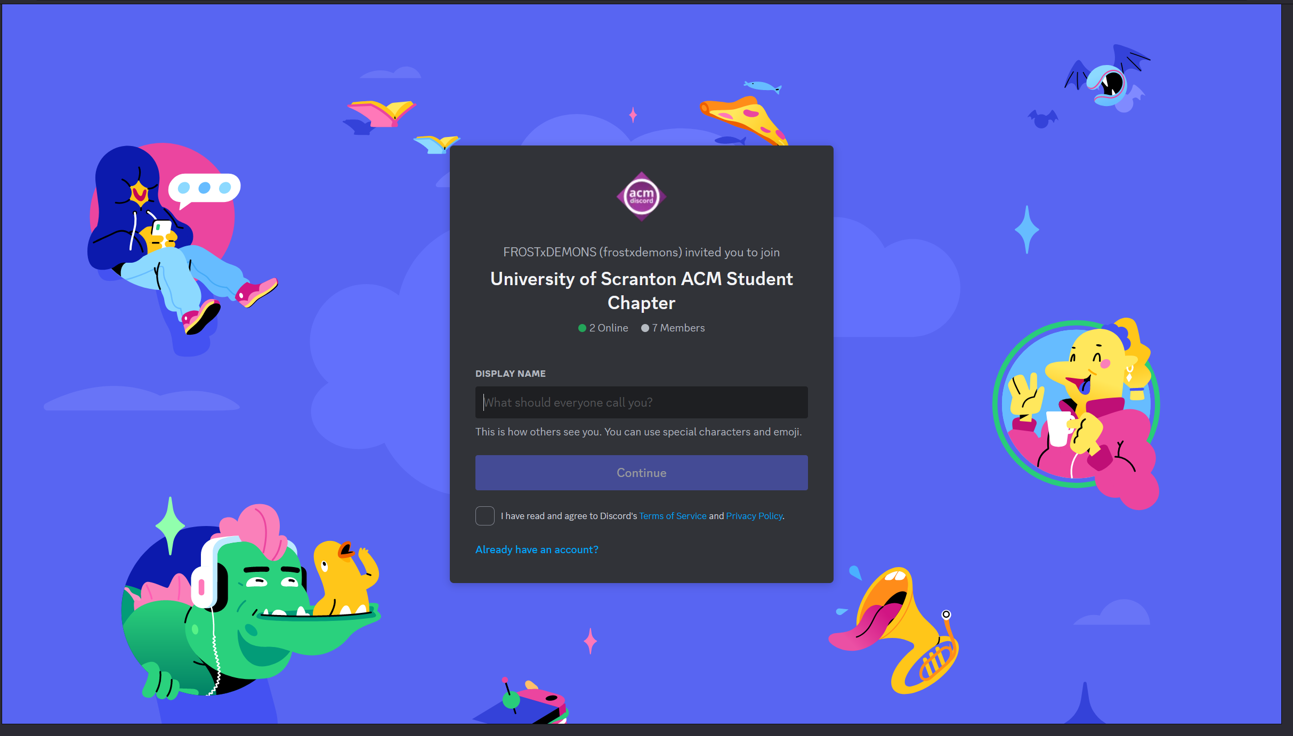


Slide 3

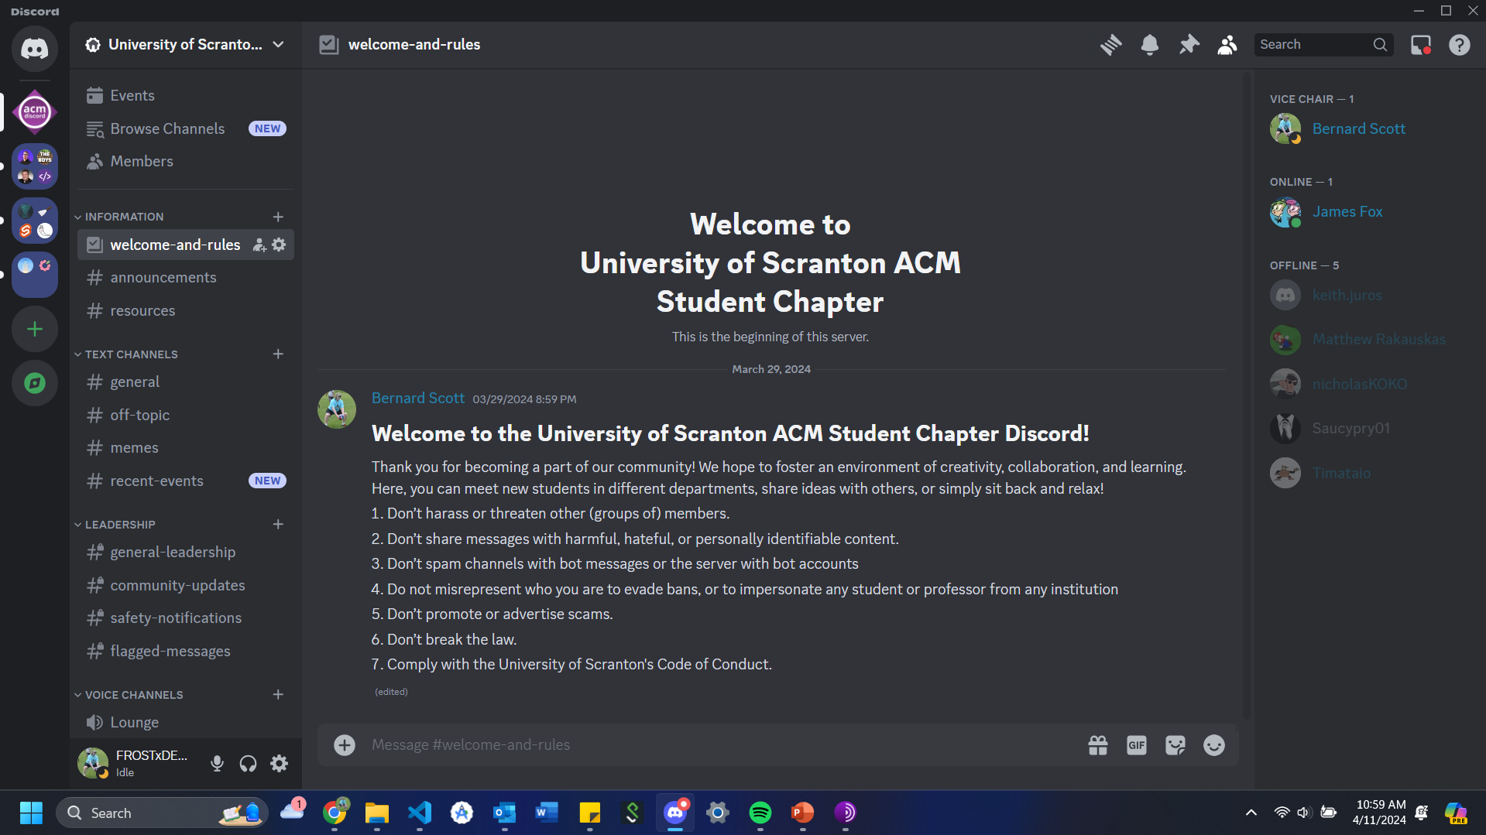
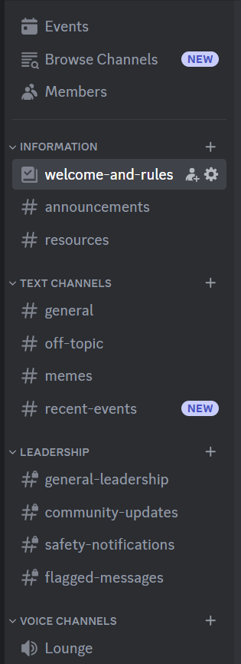
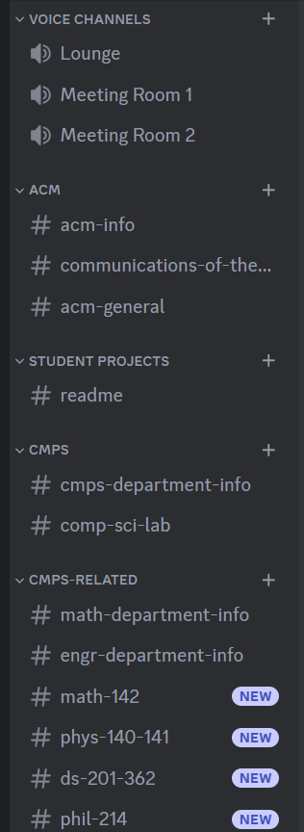


Slide 4
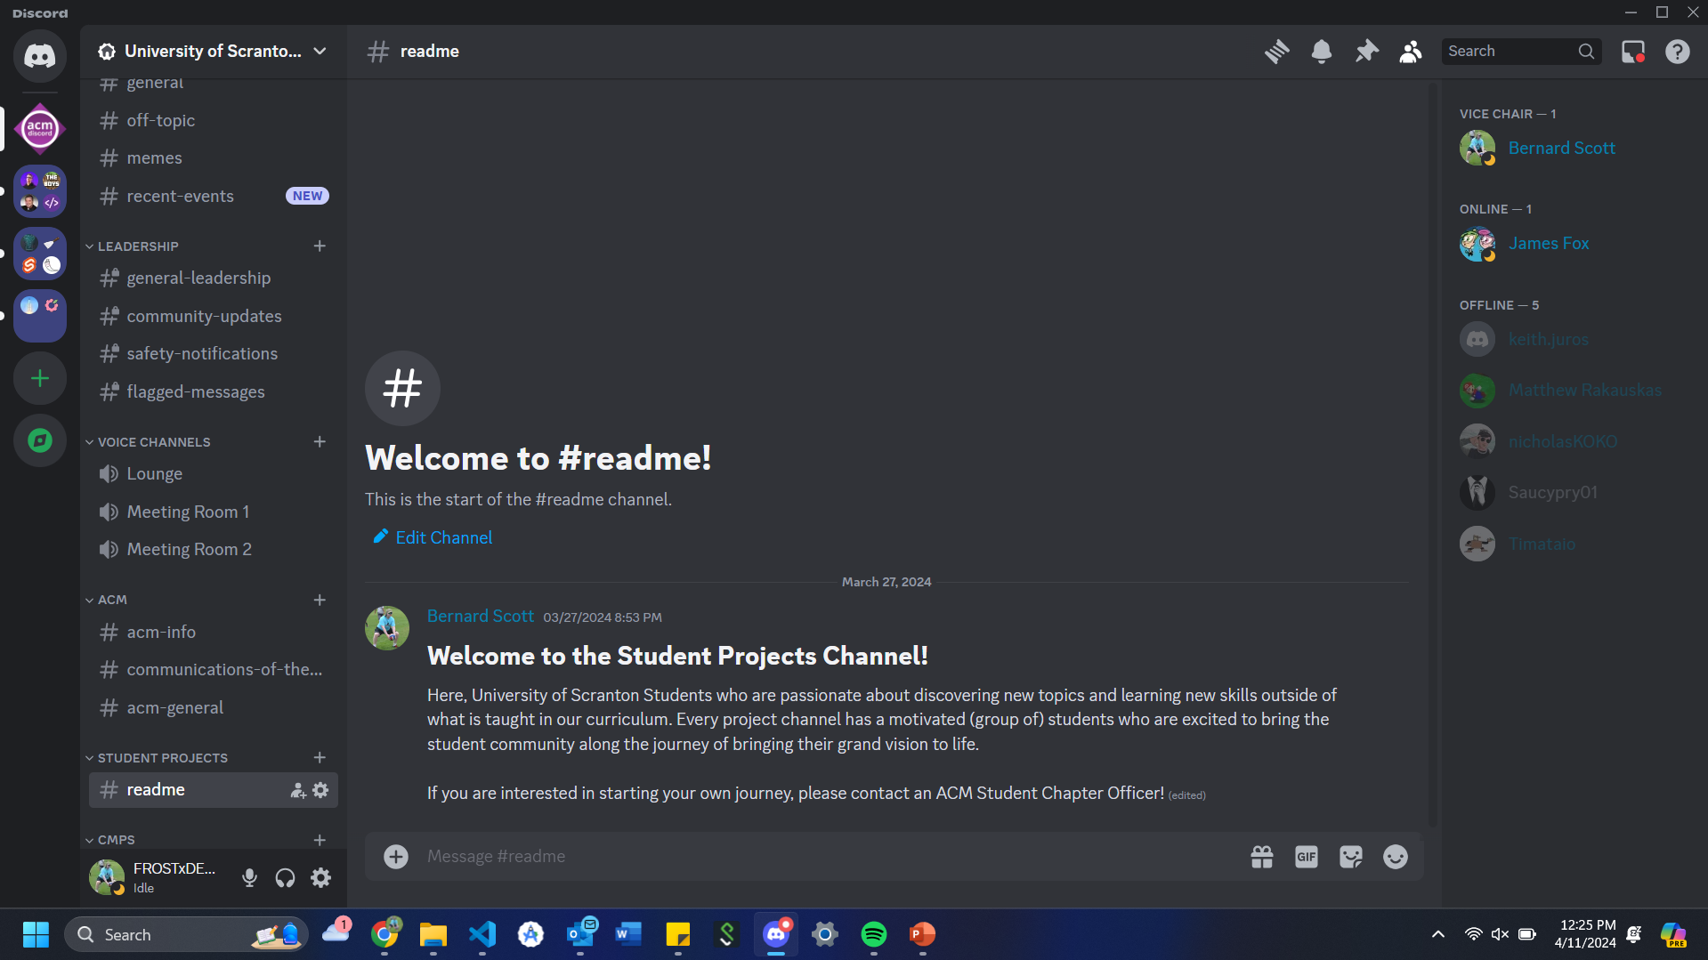

Slide 5
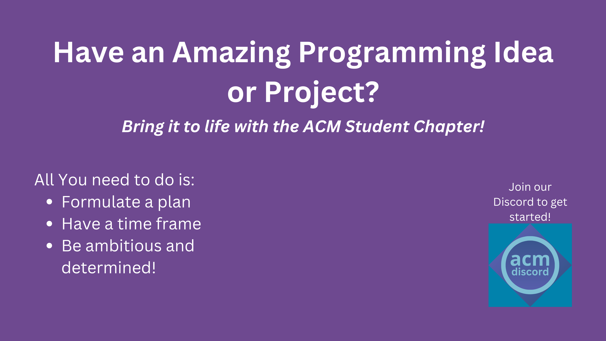

Slide 6
Now for the actual event!

Slide 7
Prerequisities

Slide 8
The Basics

Slide 9
Classes and Objects

Slide 10
Libraries

Slide 11
Compilation vs. Interpretation

